Slide 1
SALESFORCE ANALYSIS
MEMBERS
1. Mr. Swapnil Achyutrao Pagore
2. Mr. Krishna Vithal Aher
3. Mr. Thote Harshal Dattatray
4. Mr. Sanket Deepak Taskar
5. Ms. Aditi Nimje
6. Miss Livea Nora Mathias
7. Miss Rashmi Hasmukh Rathod
Under the guidance of Mr. Mahendra Singh

Slide 2

ABOUT
Analysis of data has become a severe concern whether it is service based business or product based business. The key to success for any kind of business is by building good relation with customer. The Customer Relationship Management has become necessary requirement as it helps in taking business driven decisions. The best solution for Customer Relationship Management is salesforce as it holds all the information regarding customers, workers, services that has been provided in the organization.
OBJECTIVE
• To develop a robust and sustainable field force effectiveness analysis, so as to enable the organization to effectively pursue and achieve its business objectives.

Slide 3
DATA INFORMATION
We have 5 datasets Account, Lead, Opportunity Product, Opportunity Table, User Table.
Account table has 3052 rows.
Lead table has 10000 rows.
Opportunity Table has 4647 rows.
Opportunity Product has 10000 rows.
User Table has 100 rows.

Slide 4
DATA PROCESSING
1. Data Understanding: The key to success on any data project is a thorough understanding of the data. As a result, we took the time to learn about your company's data model and domain.
2. Data Cleaning: After gathering all the information about your company, we cleaned up the accessible datasets and considered what an ideal dataset for this topic would look like.
3. Data Modelling: After confirming that the data was clean for analysis, we needed to process and model it into a dataset capable of precisely answering the business questions and producing the required outcomes.
4. Data Analysis : We used our analytical capabilities to identify insights from our new dataset and to create visualizations to describe the insights
5. Uncover Insights : Finally, we applied these insights to create business decisions and recommendations for next steps.

Slide 5
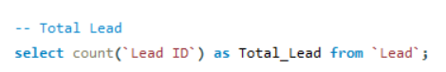
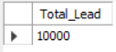
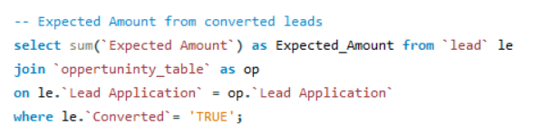
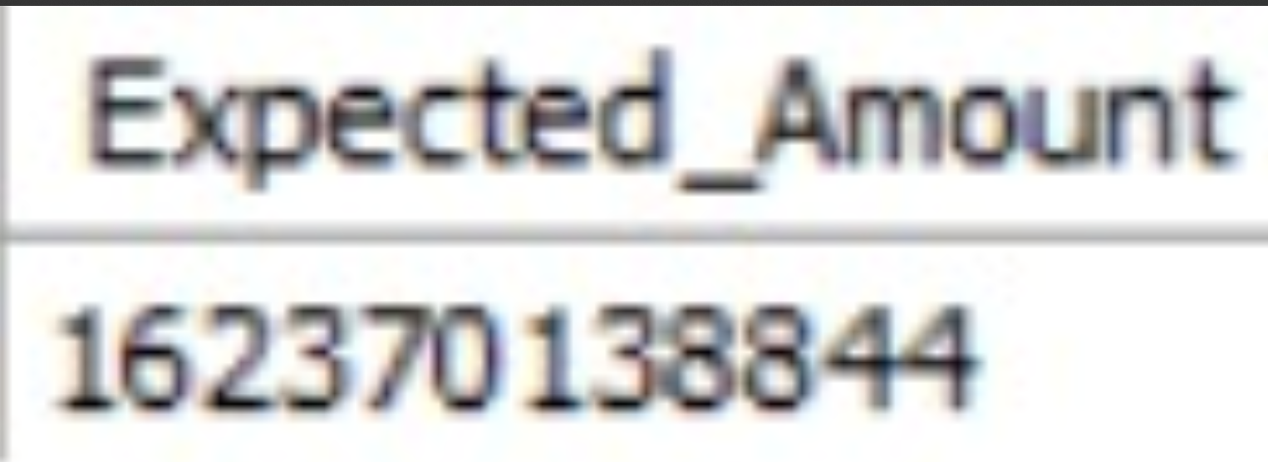
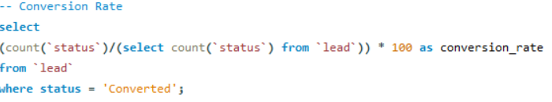
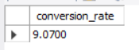
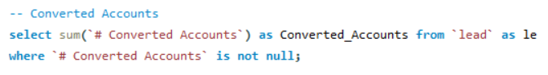
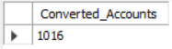
SQL
LEAD TABLE
OUTPUT
1.
2.
3.
4.

Slide 6
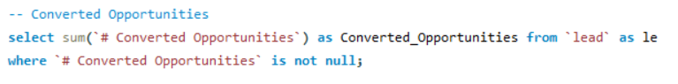
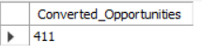
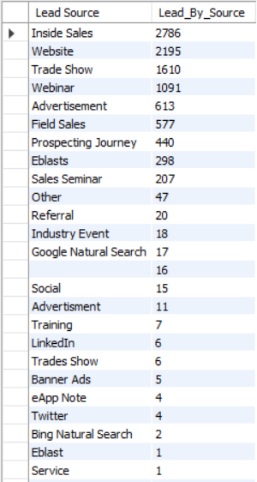
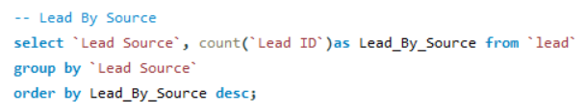
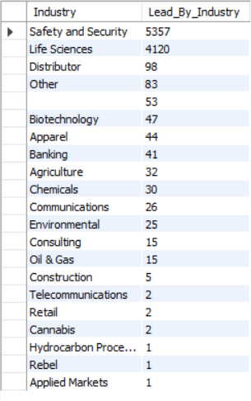
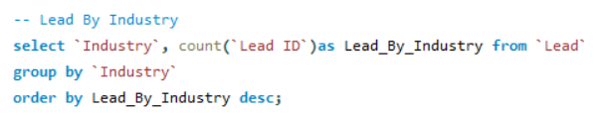
5.
6.
7.

Slide 7
EXCEL DASHBOARD
LEAD DASHBOARD

Slide 8
OPPORTUNITY DASHBOARD

Slide 9
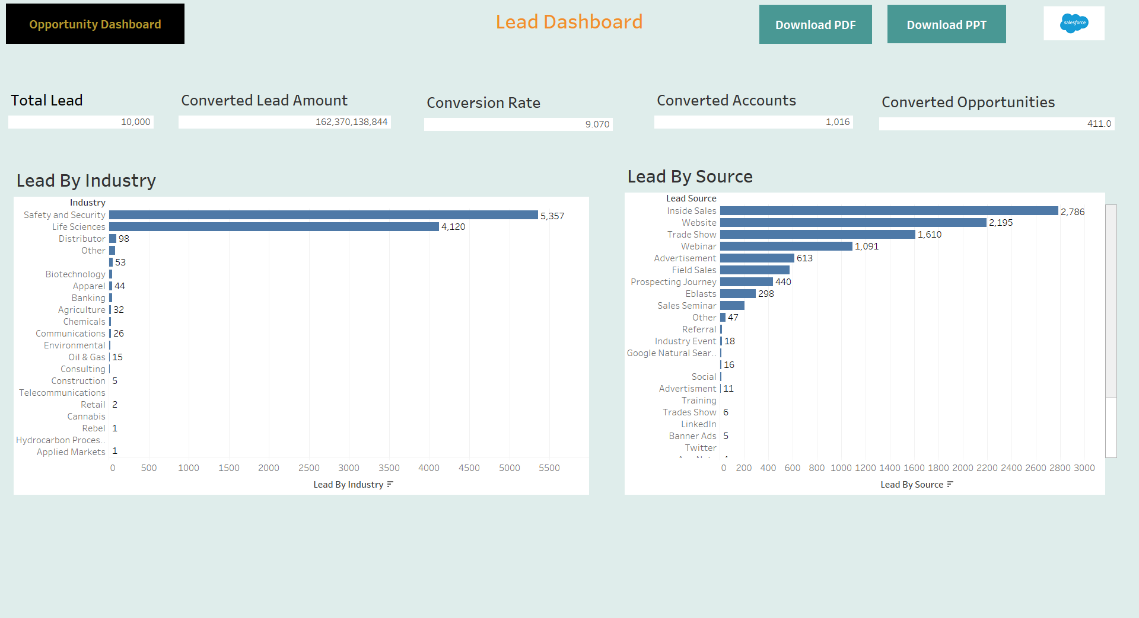
TABLEAU DASHBOARD
LEAD DASHBOARD

Slide 10
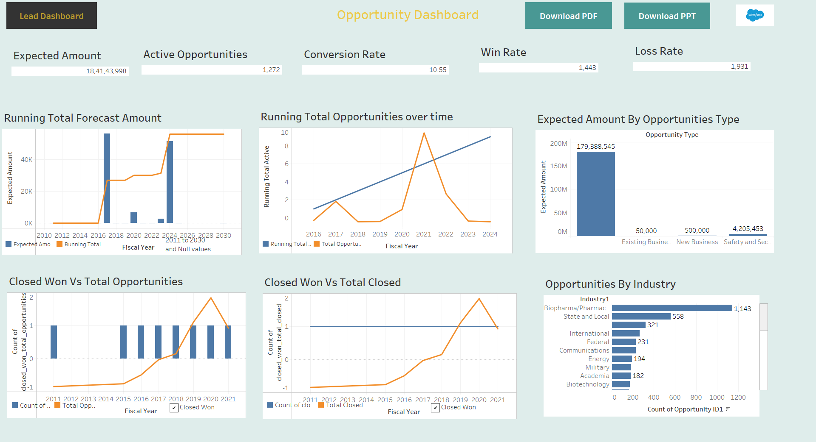
OPPORTUNITY DASHBOARD

Slide 11
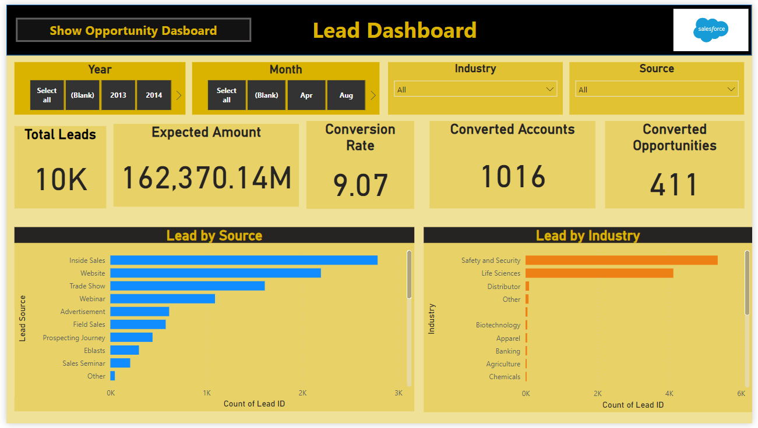
POWER BI DASHBOARD
LEAD DASHBOARD

Slide 12
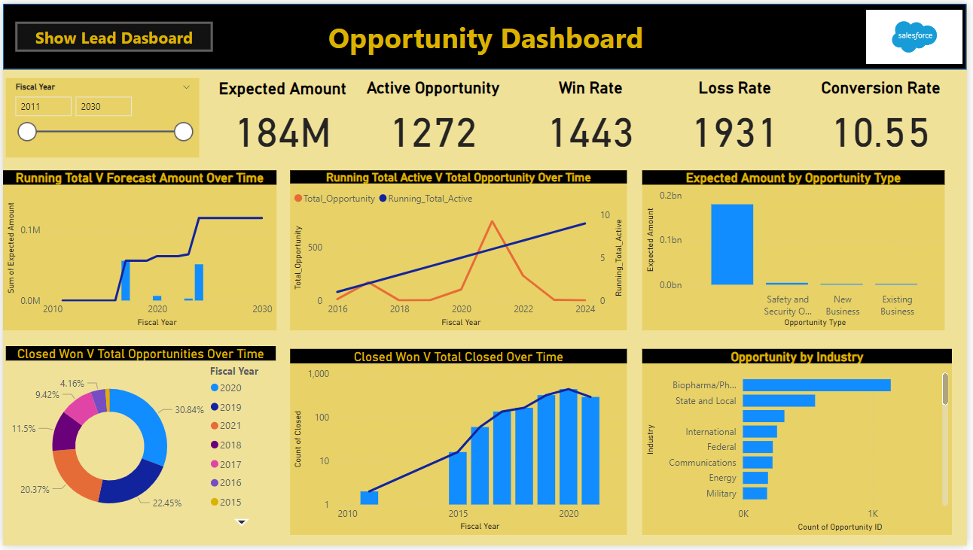
OPPORTUNITY DASHBOARD

Slide 13
CHALLENGES FACED
• We have face the issue during importing and joining all the database in MySQL.
We made adjustments in the data types for analysis purpose.
We calculated Running total and made respective changes as per requirements.

Slide 14
SUMMARY
We took on this duty and discovered that in 2020 we found the most converted accounts.
In our findings in sales occupancy , our focus on increasing the number of clients will help the Business.
From given dataset, We are able to analyse that sales is increasing year by year.
We analyse lead by source we found insights sales have highest number of lead count and we found safety and security have highest number of lead count.
We found that in 2021 most active opportunity were recorded.

Slide 15
THANK YOU!

